Slide 1
Accenture | VMware
America’s Insider
October 21, 2011

Slide 2
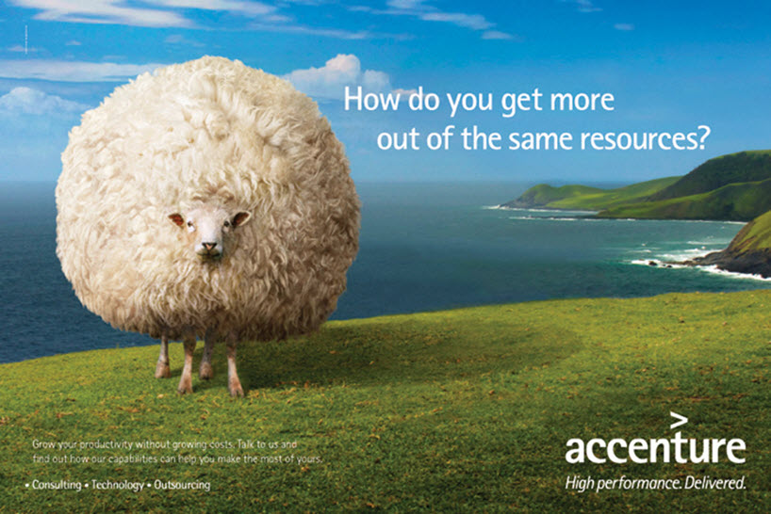
Who is Accenture?

Slide 3
Why are they important?
3rd Party Influence on Customers
200
3rd
150
100
2nd
50
1st
0
Communities
And Users
Groups
SIs /
Management
Consultants
Technology
Vendors as
Advisors
Industry
Peers
Analysts
75
50
3rd
2nd
25
0
1st
Infosys
PWC
Tata
Wipro
CSC
IBM GS
Accenture
Deloitte
HP/EDS
Capgemini
McKinsey & Co

Slide 4
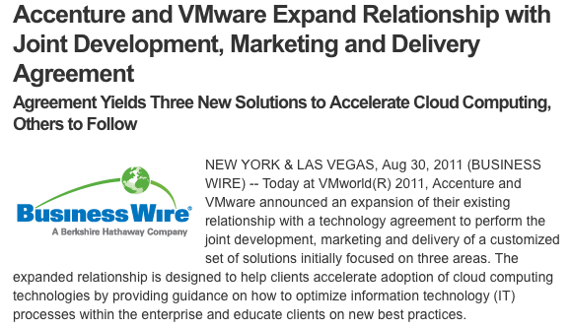
Accenture | VMware :: Joint Initiative
Signed Agreement for Joint Initiative to deliver high-value solutions
Accenture providing a GTM team to drive joint solutions
Accenture-badged delivery workforce within PSO
VMware providing alliance team to drive joint solutions
Goal—Increase mindshare of VMware within Accenture
Increase sales of VMware products and Accenture services
Combine VMware products with Accenture’s delivery assets and experience into defined business solutions
http://www.accenture.com/us-en/Pages/service-alliance-vmware.aspx

Slide 5
Overview
Solution
Outcome
Transforming Operations for Virtualization (TOV)
A robust operating model, organizational design and management capability for the virtual environment
A prescriptive roadmap, blueprint and business case for building a private cloud environment and evolving to a hybrid deployment model
Cloud Strategy Enablement (CSE)
An application modernization engagement that is based on the vFabric suite of products and the Spring Application Development Framework
Application Enablement (AE)

Slide 6
Overview – VMware Journey Alignment
Cost Efficiency
Quality of Service
Business Agility
IT Production
Business Production
IT as a Service
Low
Medium/High
High/Very High
Business Value approach
VMware IT Value Transformation Roadmap
VMware Management Suite
Transforming Operations for Virtualization (TOV)
VMware
vCloud Suite
Cloud Strategy Enablement (CSE)
VMware
App Modernization Suite
Application Enablement (AE)

Slide 7
Transforming Operations for Virtualization (TOV)
Overview:
This solution is designed to help organizations overcome challenges encountered when virtualizing data centers.
Challenge
Solution
Design and deployment of an optimal organizational structure that increases productivity, reduces risk and streamlines data center operations
Siloed Organizational Structure
Design and deployment of a simplified operating model that increases agility and reduces risk & defects
Outdated Operating Model
Lack of Visibility and Enterprise Management Tools
Gain the visibility and the IT intelligence to proactively ensure service levels across the virtual environment

Slide 8
TOV – Client Pain Points & Qualifying Questions
Client Pain Points
Qualifying Questions
Organizational and operational issues (i.e., siloed org, availability, performance, SLA breach, etc.) are preventing IT from virtualizing tier 1 business applications
Lack of confidence from the lines of business in IT’s ability to achieve SLA targets in the virtual environment for tier 1 business applications
Lack of visibility across infrastructure and applications is increasing service recovery times
Are you under pressure to reduce or delay capital spend this year?
Are you experiencing continual, unexplained, or unplanned operational outages within your virtual environment?
Does the current operating model for the virtual infrastructure include a set of management and monitoring tools that can automate manual operational processes and proactively ensure optimal resource utilization?

Slide 9
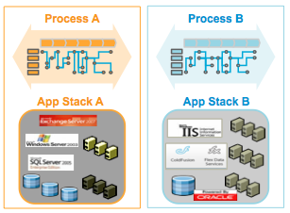
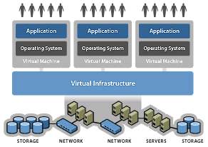
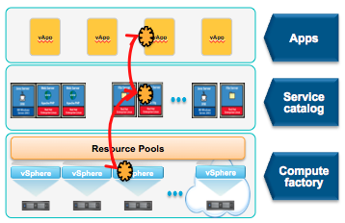
The Cloud Requires IT to Rethink Management
The TOV solution enables organizations to build a robust operating model for the virtual environment and transition to a service orientation. This is a prerequisite for cloud.
TOV Solution
CSE Solution
Traditional IT Operating Model
Virtual Infrastructure Operating Model
Cloud Operating Model & Strategy
Business Value

Slide 10
Cloud Strategy Enablement (CSE)
Overview:
This solution enables organizations to understand the business benefits of private and hybrid cloud deployment models. The business case is supported by a prescriptive roadmap and blueprint that will enable the realization of the desired architecture.
Challenge
Solution
Inability to Quantify the Business Benefits of Private & Hybrid Cloud Solutions
Detailed understanding of the business, IT and Application Development benefits of Private & Hybrid Cloud solutions
No Vision or Roadmap to the Cloud - Uncertain about the Organizational and or Operating Model Impact of Cloud
Develop a roadmap & action plan that will enable your organization to achieve the economics & agility of cloud without sacrificing security or control
Increase business agility by empowering users to rapidly deploy services on-demand with self-service provisioning portals
Demand from Application Developers and LoB’s for Self-service IT Services

Slide 11
CSE – Client Pain Points & Qualifying Questions
Client Pain Points
Qualifying Questions
Lack of clarity and uncertainty about the impact private and hybrid cloud solutions will have on IT and the business
Lack of cohesive vision and strategy for cloud that aligns business requirements with IT capabilities
Misalignment across stakeholders and constituents is preventing the organization from moving forward with cloud solutions
Does your organization understand how cloud will integrate with the existing IT operating model?
Does your organization understand the specific business and IT benefits of moving to a private or hybrid cloud deployment model?
Has your organization developed an implementation plan for cloud that addresses organizational, people, process and technology considerations?

Slide 12
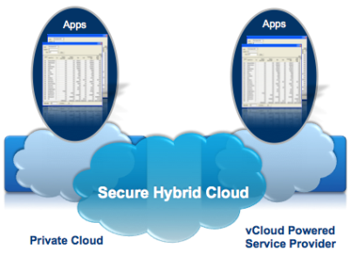
Cloud Strategy Enablement (CSE)
The CSE solution enables organizations to build private clouds and connect to vCloud Powered Service Providers. It does this by quantifying the business benefits, cloud strategy and developing a realistic roadmap to achieve the desired results.
TOV Solution
CSE Solution
Virtual Infrastructure Operating Model
Cloud Operating Model
Hybrid Deployment Model
Business Value

Slide 13
Application Enablement (AE)
Overview:
This solution leverages the VMware vFabric® Cloud Application Platform and Spring development environment to modernize and simplify the cost and complexity of new and existing applications
Challenge
Solution
Prepackaged architectural assets help you rapidly create new applications or modernize existing ones
Application Development Timeline
Design and deployment of a lightweight platform for building and running modern applications that are ideally suited for a virtual or cloud environment
Heavyweight Application Architecture
Real-time business with in-memory data processing with elastic infrastructure scalability
RDBMS Scale, Latency and Cost

Slide 14
AE – Client Pain Points & Qualifying Questions
Client Pain Points
Qualifying Questions
Cost and complexity of legacy application architectures and portfolio
Bloated application architecture that is expensive to manage and maintain
Expensive mainframe based applications and batch processing
Database scalability and performance bottlenecks are negatively impacting user experience for web-oriented, data-intensive applications
Does your organization have a desire to rationalize and simplify the application portfolio?
Does your organization have a lean application architecture vision and strategy that will enable the business to cut costs, improve agility and consolidate the IT infrastructure?
Does your organization have a desire to off-load applications and batch processing from the mainframe?
Does your organization have a distributed data management platform strategy?

Slide 15


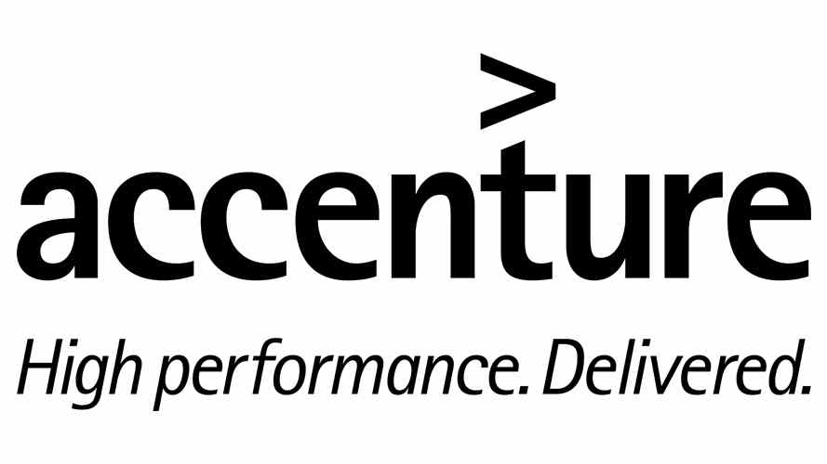



Application Enablement (AE)
The Application Enablement (AE) solution is based on Accenture's proven solutions to modernize applications for the future utilizing the power and flexibility of VMware’s vFabric suite of products and the and Spring Application Development Framework.
Accelerate Time to Value
+
The delivery of high-quality, business-critical applications
Reduce Cost and Complexity
Throughout the lifecycle
Rapid Cost Takeout
From developers to datacenter

Slide 16
Joint Solutions: VMware Account Team Benefits
Solution
Product Sales
VMW Mindshare/Usage
vSM | vCOPs
vCM | Cap IQ
ADM
VMW mindshare w/”C” suite
% of IT spend on VMW
Adoption & usage of VMW
Deliver sustained value
TOV
VMW mindshare w/”C” suite
% of IT spend on VMW
Adoption & usage of VMW
Clients realize benefits of hybrid clouds
vCD | vShield
vSM | Chargeback
AppSpeed
CSE
SQLfire | GemFire
ers | tc Server
Rabbit MQ | Spring
VMW mindshare w/”C” suite
% of IT spend on VMW
Adoption & usage of VMW
Clients realize benefits of advanced VMW solutions (vFabric/Spring)
AE

Slide 17
Global SAP Private Cloud Solution
Accenture’s SAP Private Cloud offering provides clients with a fixed price, managed service solution for virtualizing and running SAP in a private cloud, as opposed to clients’ current non-virtualized legacy systems.
Created jointly by Accenture, SAP, Cisco(UCS/switches), NetApp (FlexPod), VMware (vSphere, vCD, CapIQ, AppSpeed), Red Hat(Enterprise Linux), and RealTech (SAP services)
Benefits:
Dramatically shortens the time to deploy new SAP environment - from days to hours
Provides clients with the competitive advantage of SAP’s analytics and mobility capabilities.
Security & Manageability of a private cloud with public cloud economics
Reduces TCO, increases flexibility, security and improves business results

Slide 18
Success Story: Freeport McMoRan
Background
Freeport-McMoRan is the world’s largest publicly traded copper company, with revenues >$19B, operating across 6 continents
Challenge
Following a major US acquisition, needed increase of systems scalability and performance. Existing infrastructure and ERP environment was inhibiting growth. Unable to have outsource option due to complex manageability and serviceability, and disparate tools
Value Delivered
Accenture’s awarded ERP transformation because of their experience in SAP deployments. Accenture created a private cloud architecture to increase platform utilization, while simplifying ongoing management and operations support. Lead time for SAP restorations reduced from hours to minutes. Virtualization of Tier 1 app resulted in a much smaller hardware footprint and greatly reduced storage platform.

Slide 19



Success Story:
Background
The Internal Revenue Service (IRS) Next Generation Public User Portal (PUP)
started out as a PoC in 2010. Accenture won the contract in July 2010 and will
run the Application Infrastructure for the IRS for the next 9 years
Challenge
The IRS needed to be able to change the website in real time, especially in the
months leading up to tax time in April. Site has to be 99.99% available, with BC/DR
capabilities in case one data center goes offline.
Products Sold
The new Dynamic Web Content Management System (CMS) stack will be 100% virtualized.
A state-of-the-art web-caching service will be used to provide load balancing during times
of high demand. FY11Q3 win consisting of $450K of VMware product and support
including vSphere, SRM, and vCenter Orchestrator (even though Opalis was quoted in the
RFP and built into the PoC). PSO services were sold as sub to Accenture. Future
opportunities include 2 additional portals as well as selling additional product such as VCOps,
vShield, and VSM.

Slide 20
Call To Action
Determine which of your accounts have an Accenture presence
Quarterback your territory
Identify the top TOV, AE, CSE opportunities in your territory – Focus on areas of change (i.e., M&A, DC Migrations, new market, etc.).
Exploratory call with VMware ACN Sales Teams
Known organizational or operational issues
Known portfolio rationalization initiative
Known private cloud strategy initiative
Large mainframe environment
Purchase patterns, etc.
Accenture VMware joint account planning session with high propensity to buy accounts
Leverage JI as a way to introduce solutions to the account & raise awareness on solution benefits

Slide 21

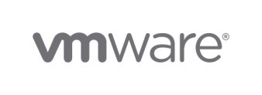
Contacts & Additional Information
Bruce Jennings – GTM Lead
b.jennings@accenture.com
+1 (214) 215-0608
TBH: Bruce Jennings Acting – West Region
Ryan Hosey – Central Region
ryan.hosey@accenture.com
+1 (972) 746-8241
Kent Oldenburg – East Region
Kent.t.oldenburg@accenture.com
+1 (770) 364-8591
Mark Wurden – Technical Domain Architect
Mark.wurden@accenture.com
+1 (972) 603-6906
Rob Harper – Sr. Dir SISO – JI Lead
rharper@vmware.com
+1 (919) 341-6778
Greg Andsager – GTM Lead
gandsager@vmware.com
+1 (513) 417-9023
Jan LeVine – West Region
levinej@vmware.com
+ 1 (949) 633-5271
TBH: Jan LeVine Acting – Central Region
TBH: Jan LeVine Acting – East Region
Linda Hummel – West/South Central TSA
lhummel@vmware.com
+1(949) 632-1410
Joshua Lory – East/Central TSA
jlory@vmware.com
+1 (631) 403-0884

Slide 22

Assets & Resources
Search VMVAULT for “Accenture” or click on image below.

Slide 23
Accenture – VMware
Q&A

Slide 24
VMware Account Benefits
Service Manager
vCenter Operations
vCenter Capacity IQ
vCenter Configuration Manager
vCenter Application Discovery Manager
TOV Product Sales
vFabric SQLfire
vFabric ers
vFabric tc Server
vFabric Rabbit MQ
vFabric GemFire
SpringSource Tool Suite
AE Product Sales
vCloud Director
Service Manager
vCenter AppSpeed
vShield Suite
vCenter Chargeback
CSE Product Sales
VMware Mindshare
Increase VMware mindshare with “c” suite
Increase % of IT spend that goes to VMware
Deliver sustained value through service excellence and product innovation
Accelerate VMware Product Usage
Increase adoption and use of core VMware technologies
Position account to adopt and realize the benefits of advanced VMware solutions (i.e., vSM, vCOPs, ADM, vFabric, SpringSource, vCD, etc.)
Enable clients to realize the benefits of hybrid clouds

